Slide 1


Exploratory Data Analysis on
Second-hand car trading in various cities

Slide 2
About me
Prateek Kumar (B-tech. EEE)
batch- 230

Slide 3
Agenda
Objective- to analyze which are the best second hand cars available according to our budget and requirement.
Web Scraping – (from cartrade.com)
Exploratory Data Analysis:
Data Cleaning Steps
Data Manipulation Steps
Univariate Analysis Steps
Bivariate Analysis Steps

Slide 4

Data collection – cartrade.com
URL- https://www.cartrade.com/buy-used-cars/#so=-1&sc=-1&city=105

Slide 5
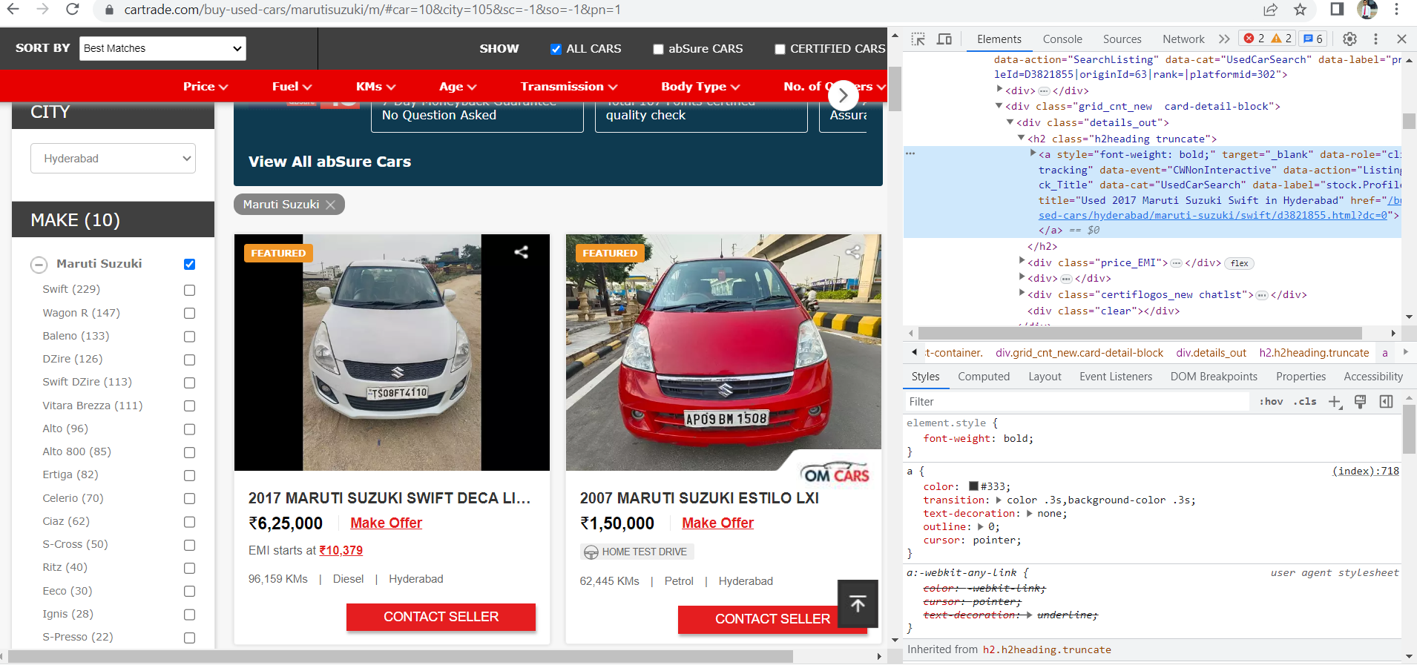
Web scrapping from the website

Slide 6
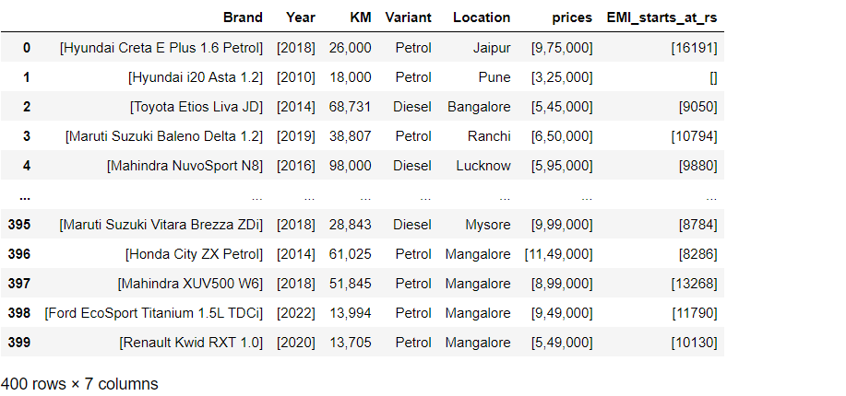
Raw Data
Here are the total eight columns.
Total 4 numerical and 4 categorical columns.

Slide 7
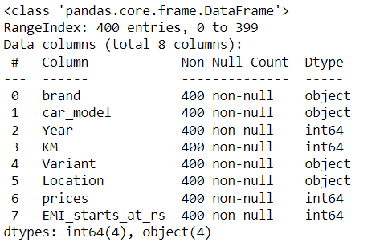
Cleaned data
Here in the section of EMI we obtain null values.
Then we had converted those null values to the mean of the column.
First we got the values in the format of list of list.

Slide 8
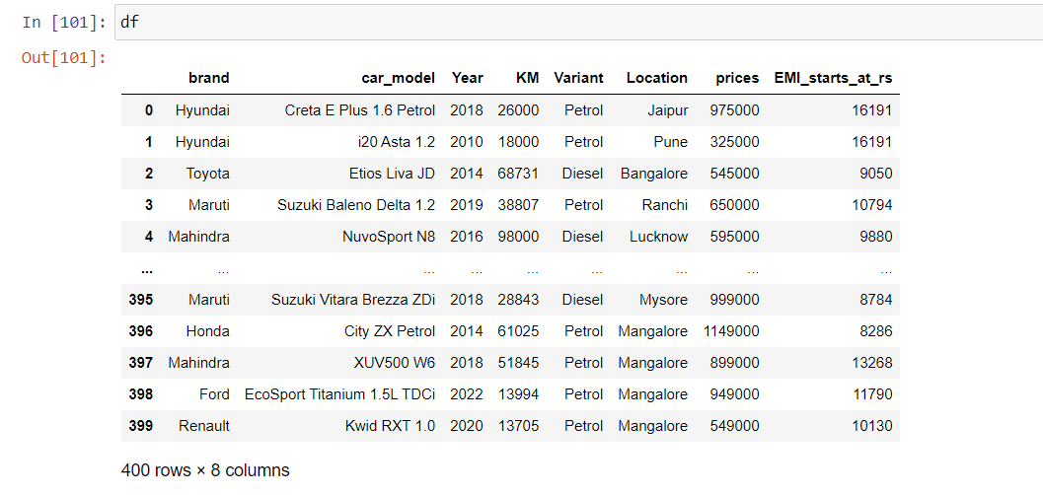
DataFrame

Slide 9
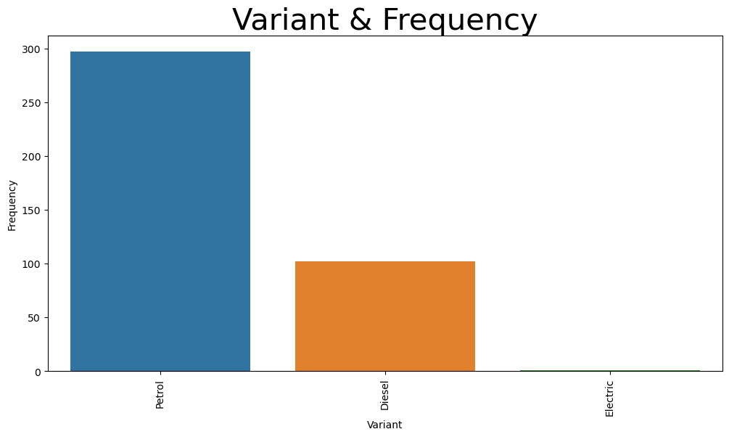
Variant
More number of petrol cars are observed to get

Slide 10
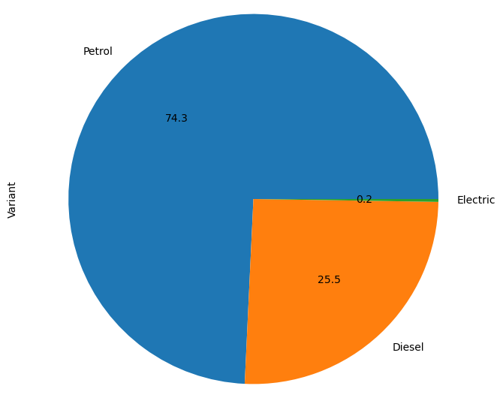
Variant pie chart
Petrol cars are nearly 75%

Slide 11
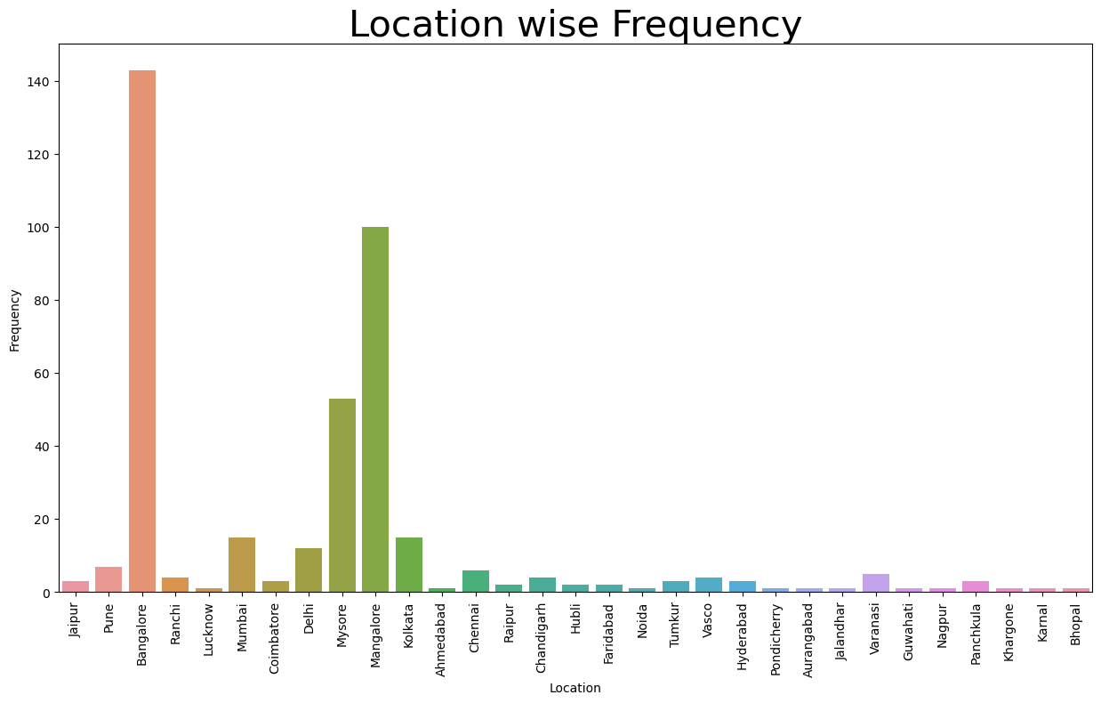
Location
Banglore and Mangalore are highest in the reselling of cars

Slide 12
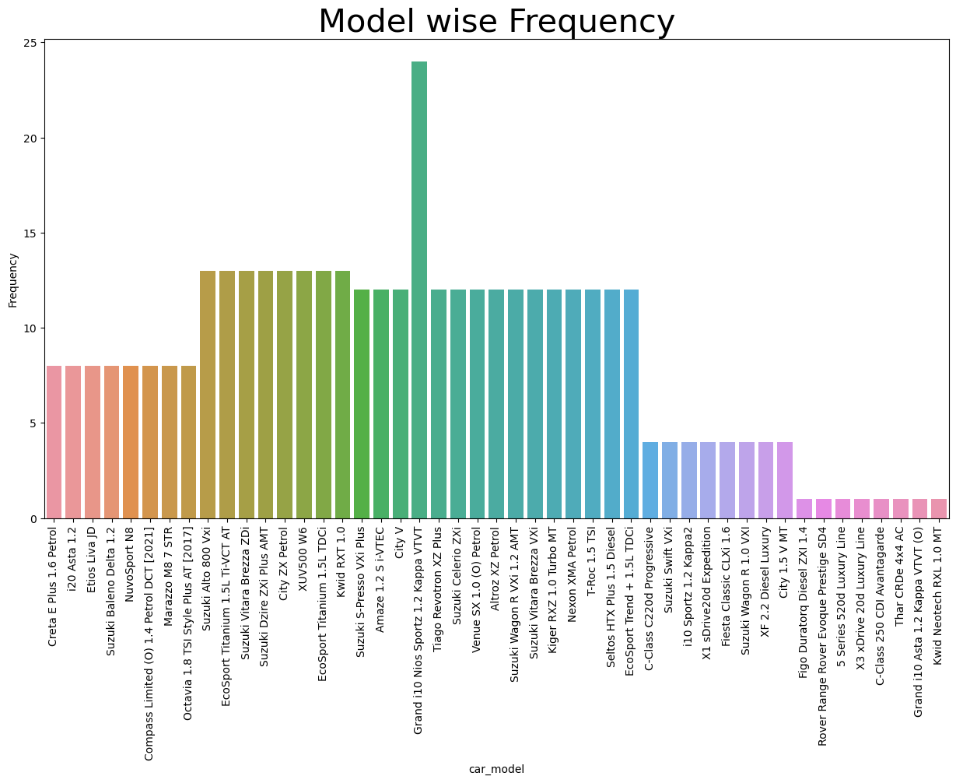
Model
When we observe the highest number of cars which are in resell is Hyundai company Grand i10 Nios version

Slide 13
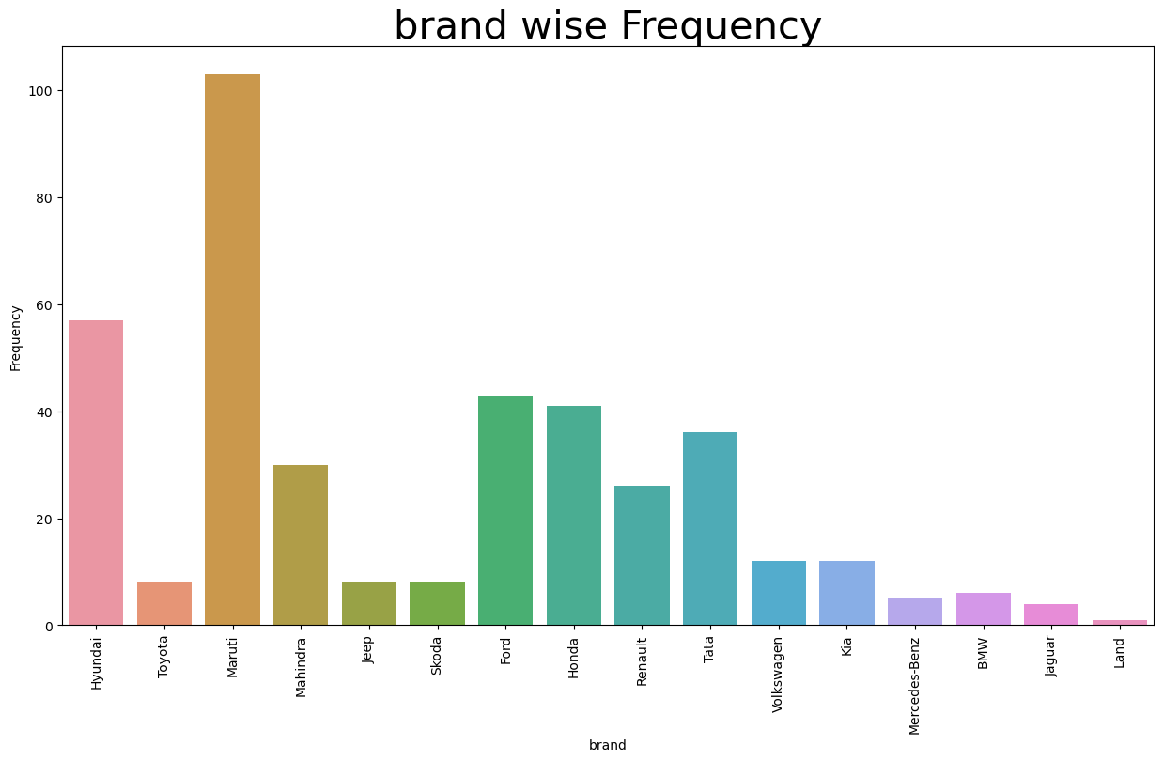
Brand
Maruti tops the reselling when compared to other brands

Slide 14
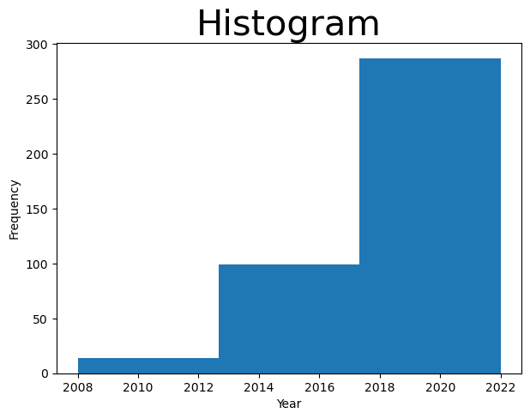
YEAR
- Model year from 2018-2022 has highest cars

Slide 15
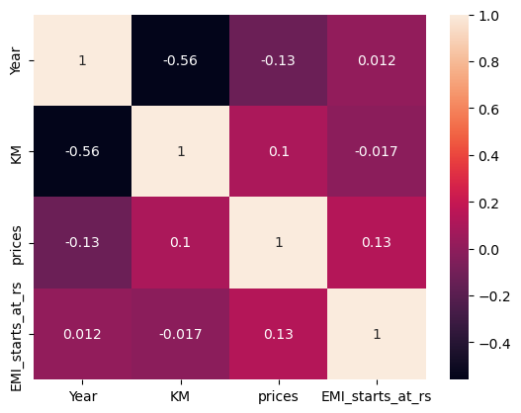
CORRELATION HEATMAP
- This map shows only Year and KM are correlated.

Slide 16
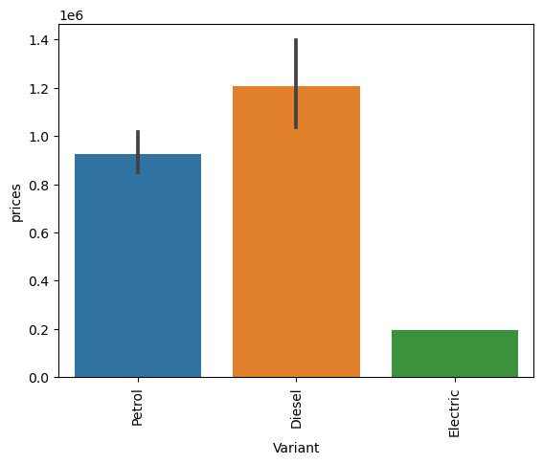
VARIANT- PRICE ANALYSIS
- Diesel cars are having more price when compared to the other cars

Slide 17
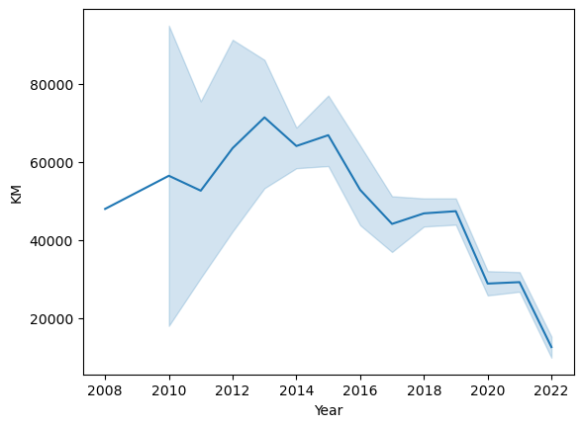
Year-KM analysis
- Negative correlation

Slide 18
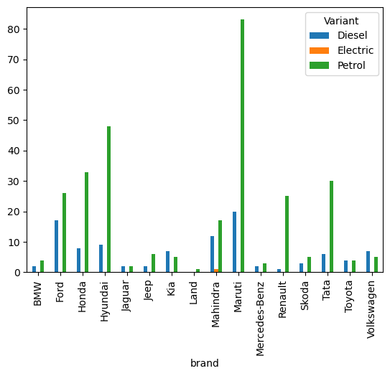
Variant -Brand
Maruti has highest number of petrol cars and Ford has highest number of Diesel cars.

Slide 19
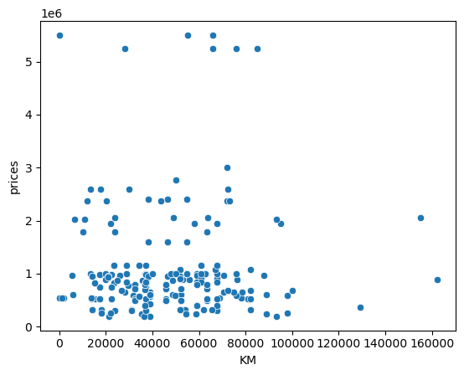
Price-KM analysis
- This graph does not show the correlation clearly.

Slide 20
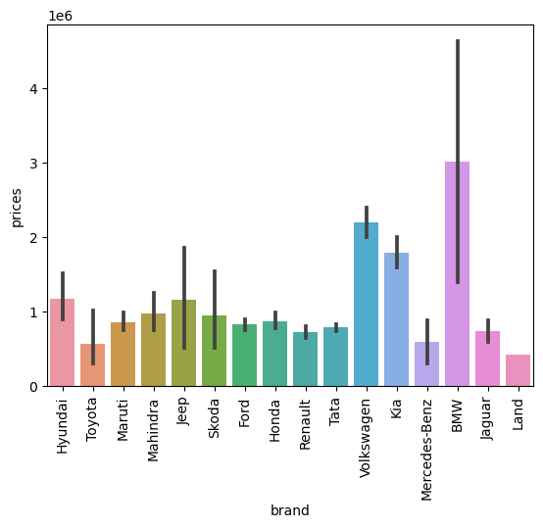
Brand – Price
-BMW cars have highest reselling price.

Slide 21
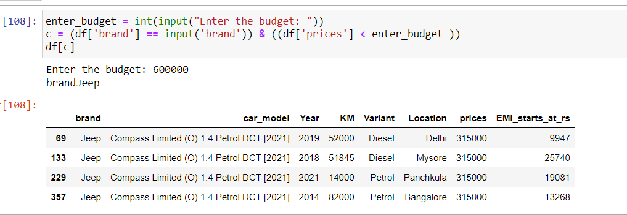
Searching Cars
- According to budget and brand

Slide 22
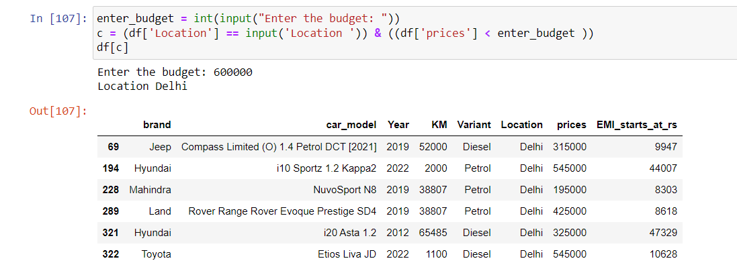
Searching cars according to city and price

Slide 23
Challenges
When the data frame is first obtained we have got the values in list of list format, with the help of explode function we have converted them into a single list.
In the EMI section we have observed some of the null values, then converted them into zeros, and then replaced them with the mean value of the column.

Slide 24

THANK YOU

